Slide 1
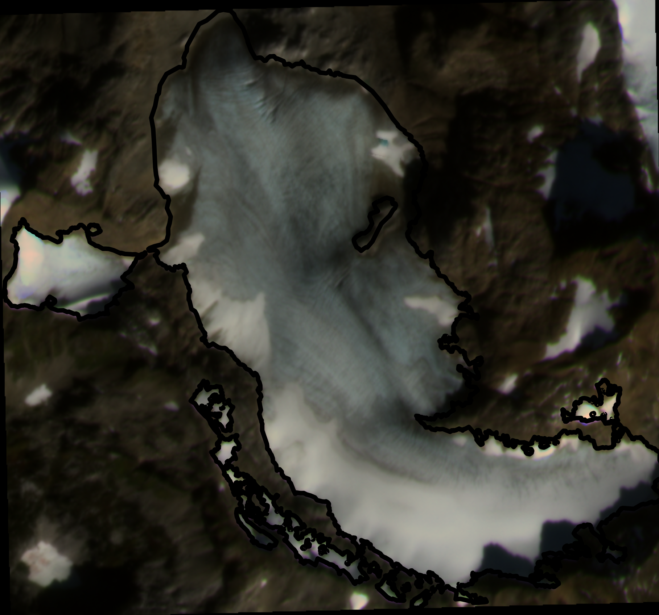
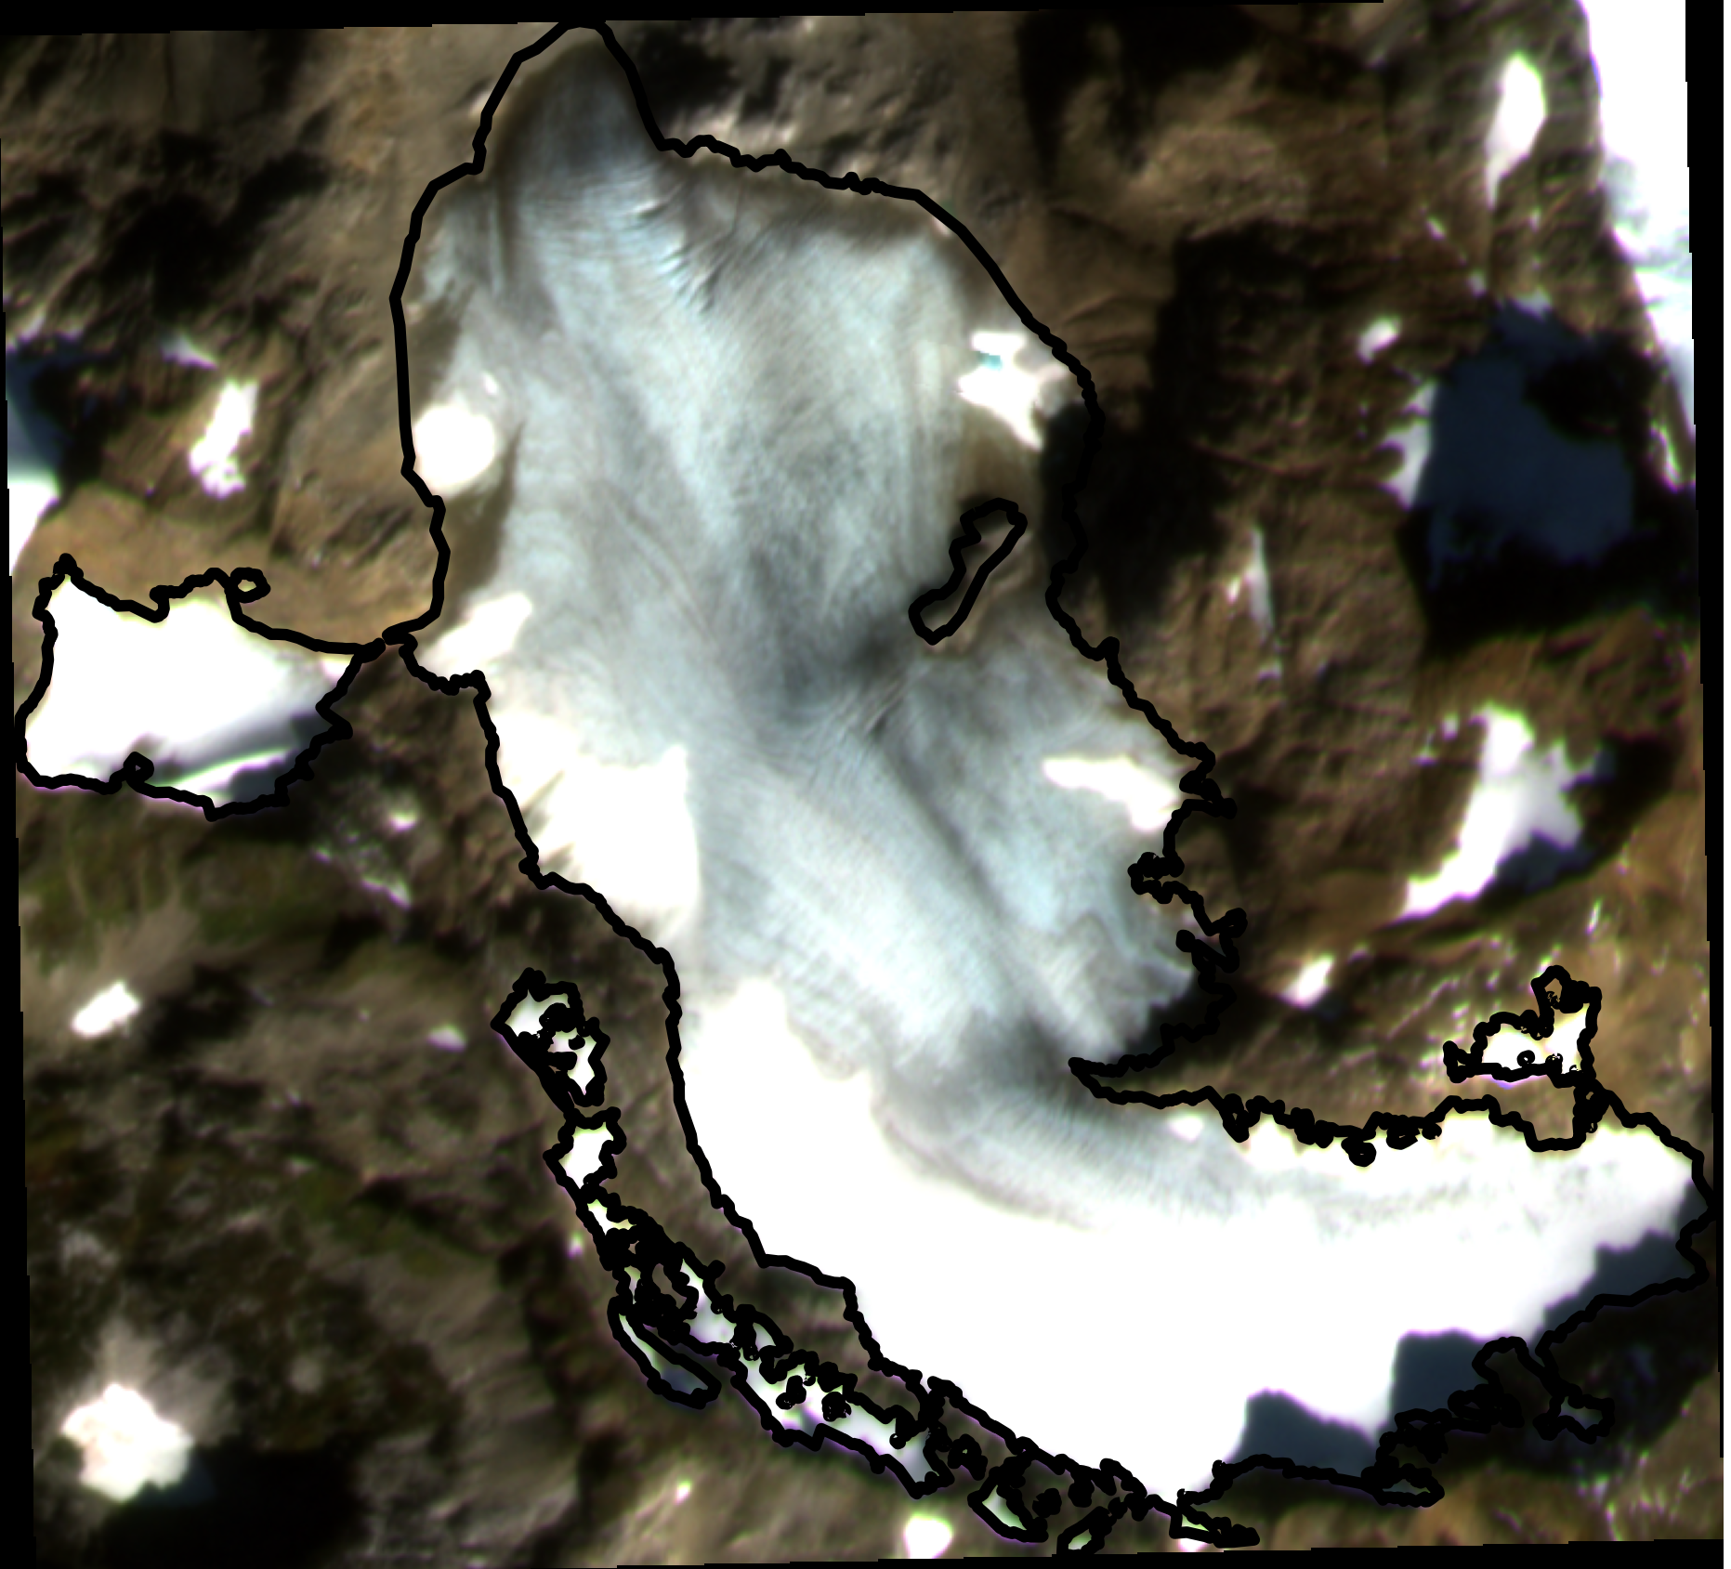
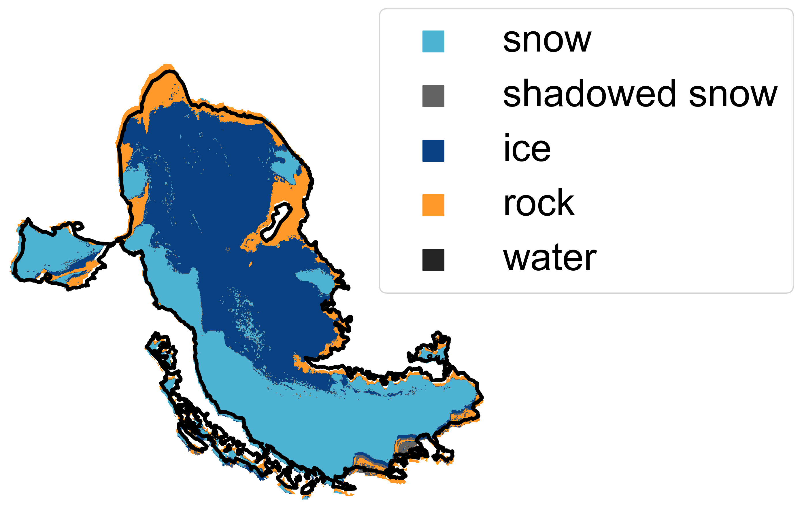
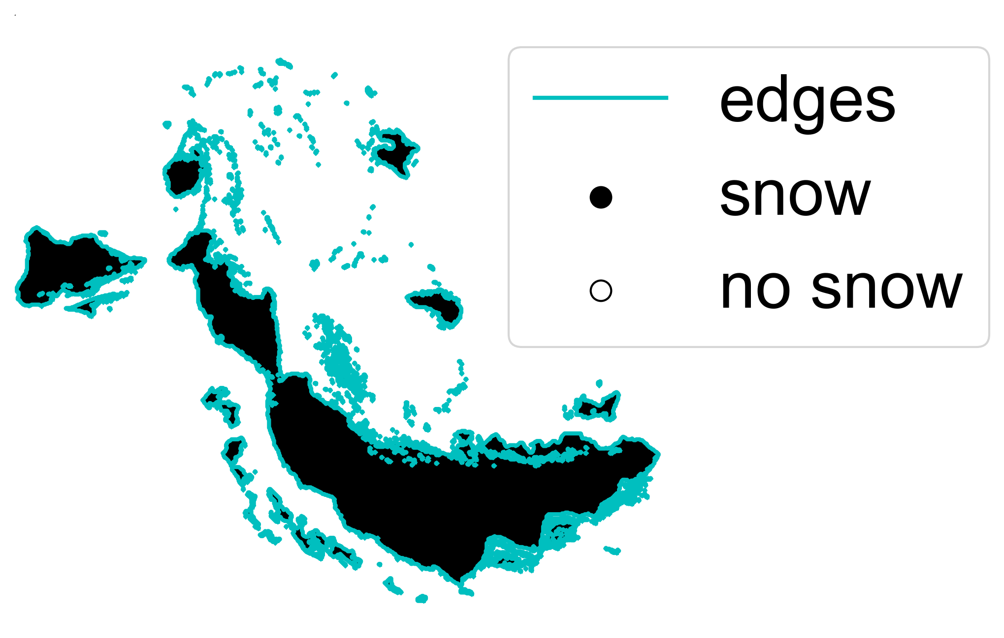
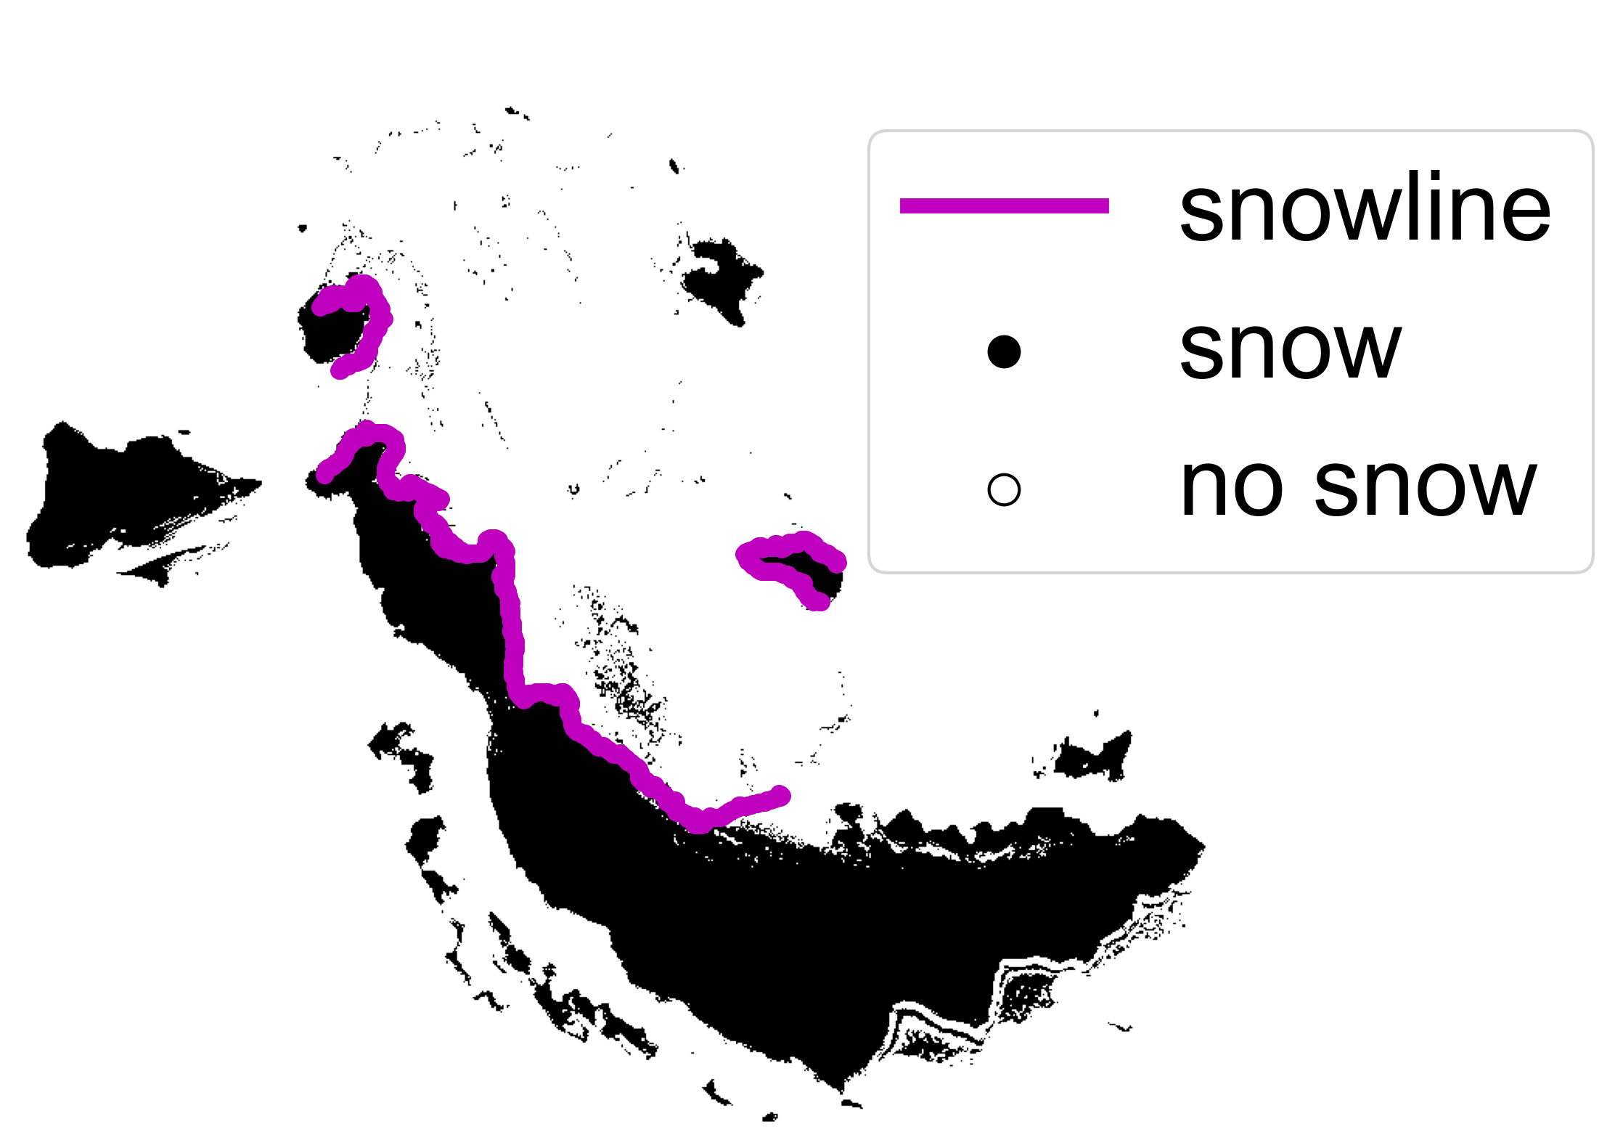
1. PRE-PROCESS
2. CLASSIFY
Landsat 8/9 SR
Sentinel-2 SR
Sentinel-2 TOA
PlanetScope 4-band SR
Filter clouds and cloud shadows
© 2021 Planet Labs PBC
Adjust radiometry
3. IDENTIFY SNOWLINES
Mosaic images captured same day
Landsat 8/9 classifier
Sentinel-2
SR classifier
Sentinel-2
TOA classifier
PlanetScope classifier
Area of Interest
Classify image collections
Create binary snow image
Identify edges
Filter edges, identify snowline(s)
Digital Elevation Model
Extract snow-covered elevations

